Slide 1

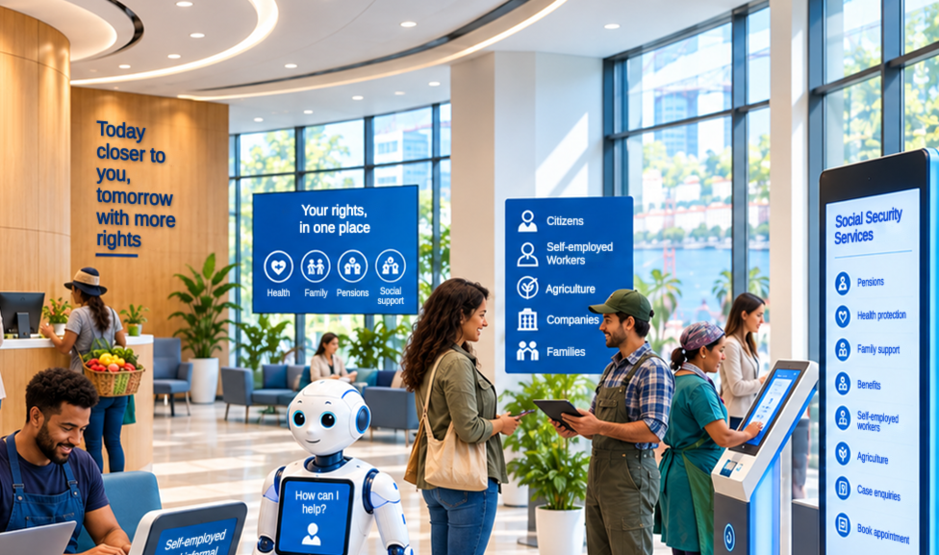
BRICS South-South Knowledge Series 2026
Social security
and the informal economy
Cooperation among BRICS institutions on digital social protection
Luis Frota

Slide 2








Digital technologies across the delivery cycle
Where digitalization supports the extension of social security to workers in the informal economy
Delivery cycle
Three core processes
1. Registration
Simple enrolment by mobile or web, portable across schemes.
2. Contribution collection
Billing and payment, with flexible mechanisms.
3. Benefits management
Applications, payment and review, end to end.
Technology enablers
Used at every stage
Identity management across agencies
Data exchange, including with payment systems
Innovative services and interfaces, such as mobile
Foundations
What everything rests on
Policy and legal framework
Capabilities: technological, digital inclusion, resilience, governance
Key message: safe and responsible digital and decision-making systems extend coverage and support the transition to the formal economy when they build on inclusive identity and data sharing, underpinned by sound policy, regulation, governance and capabilities.
Source: ILO and ISSA (2026), Leveraging Digital Technologies to Protect All Workers, including Gig and Platform Workers, technical paper for the 2nd meeting of the BRICS Employment Working Group (Priority 4), draft version, April 2026.

Slide 3

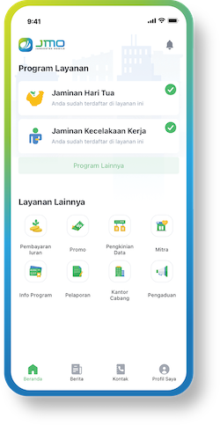
Five BRICS practices: what works, and what each one teaches
Ordered along the delivery cycle, from registration to automated delivery at scale
India — e-Shram
Ministry of Labour and Employment
306 million registered (Jan. 2025) by self-declaration linked to Aadhaar; assisted registration; 22 languages.
Lesson: where registration depended on digital identity, many informal workers were excluded.
+4
million
installations
Iran — Tamin-e Man
Iranian Social Security Organization (ISSO)
53 electronic services in one app (86% user satisfaction); online registration portal.
Lesson: bringing many services together in a single digital access point encourages use.
100%
digital
registration
UAE — integrated registration
Abu Dhabi Pension Fund (ADPF) · scheme for UAE citizens
Fully digital registration, integrated with the identity authority and the Central Bank; no visits, no paper.
Lesson: when systems exchange data, people no longer have to provide them.
Indonesia — Jamsostek Mobile (JMO)
BPJS Ketenagakerjaan
Registration, non-wage worker contributions and old-age savings (JHT) claims in the app (72% of JHT claims).
Lesson: an app relieves service counters only if the service is completed end to end.
6+
million
beneficiaries in under 3 months
South Africa — SRD grant
SASSA · Social Relief of Distress (SRD) grant
Digital-only grant by web, USSD and WhatsApp, with automated eligibility checks.
Lesson: speed at scale, but digital-only delivery without human support brought exclusions.
What the five cases show
Integration and automation deliver speed and scale. Inclusion depends on identity, channels and human support.
Sources: Press Information Bureau and Ministry of Labour and Employment, Government of India (2025); ISSA good practices: Tamin-e Man and ES.tamin.ir (2024), “Starting smartly” (ADPF, 2024), JMO (2021); study published on ScienceDirect (2025) on JMO; South Africa: account of the SRD grant implementation (source to be added).

Slide 4
Five areas for cooperation, each anchored in a tested practice
Start from the problem: who has a tested answer, and what can be shared
AREA FOR COOPERATION
THE PROBLEM
TESTED ANSWER FROM
WHAT CAN BE SHARED
1. Registering informal workers at scale
Stage: registration
How to register millions of unorganised workers who are in no registry and may need assistance?
India
Ministry of Labour and Employment
Self-declared registration linked to digital identity, assisted registration, access in 22 languages.
2. A single access point for services
Stage: all stages
How to give insured persons, pensioners and employers one place to reach many separate services?
Iran
Iranian Social Security Organization
One app with 53 services, and a portal for online registration, including the self-employed.
3. Data exchange between public entities
Enabler: identity and interoperability
How to stop asking people for documents that other entities already hold, and reduce errors and delays?
United Arab Emirates
Abu Dhabi Pension Fund
Fully digital registration, integrated with the Federal Authority for Identity and Citizenship and the Central Bank.
4. End-to-end mobile services
Stage: contributions and benefits
How to relieve congested service counters and collect contributions from non-wage workers?
Indonesia
BPJS Ketenagakerjaan and BPJS Kesehatan
Registration, contributions and old-age savings claims in one app; tele-collectors for follow-up.
5. Automated delivery at scale
Stage: registration and benefits
How to reach millions of first-time applicants within weeks when offices are closed?
South Africa
South African Social Security Agency
Applications by web, USSD and WhatsApp; automated eligibility checks; lessons on exclusion and human support.
Source: synthesis of the practices on the previous slide and of ILO and ISSA (2026), Leveraging Digital Technologies to Protect All Workers, including Gig and Platform Workers, technical paper for the 2nd meeting of the BRICS Employment Working Group (Priority 4), draft version, April 2026.

Slide 5
Eight critical questions, in three groups
What institutions need to answer together, from the five practices and the ILO–ISSA technical paper
Access: reach every worker
Systems: deliver at scale, safely
Institutions: lead the change
1. The right channel for each user
Which channels reach workers without a smartphone, connectivity or digital skills, and who assists them?
3. Interoperability with identity and payments
Which data can entities exchange so that people no longer provide them, and with which safeguards?
4. End-to-end automation
End to end means avoiding fragmented, disconnected solutions: is the back office automated as well as the front end?
7. Innovation management
How do institutions foster innovation ecosystems, experiment with partners and scale what works?
2. Inclusive digital identity
Identity must be inclusive: how do workers who cannot be verified digitally register and access services?
5. Automated decision-making
How to gain scale and speed without losing inclusion and accuracy?
6. Data protection and accountability
How are privacy, accountability and grievance mechanisms guaranteed when data are shared?
8. Governance of transformation
Which institutional and managerial governance keeps organizations inclusive, human-centred and agile as they adopt new technologies?
Source: ILO and ISSA (2026), Leveraging Digital Technologies to Protect All Workers, including Gig and Platform Workers, technical paper for the 2nd meeting of the BRICS Employment Working Group (Priority 4), draft version, April 2026; practices cited on slide 3. Themes 5, 7 and 8 added by the author.

Slide 6
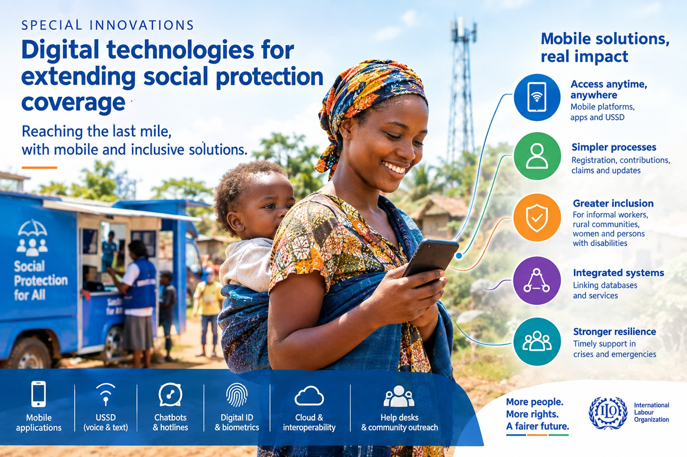
Co-creation happens in a network: many ways to learn
Showcasing, field visits, joint projects, training and advice connect institutions, organizations and partners
China — MOHRSS and Social Security Administration
Showcasing and field visits to innovation labs
ISSA innovation hub
Collaborative projects; a BRICS dimension could be integrated
Employers and workers
Digital literacy, digital culture and meaningful representation in deciding new decision-making systems
India — ESIC
Leads ISSA innovation hub projects
UN AI network (Macau)
Global South and global majority perspectives
ILO Partnerships Department
South-South and triangular cooperation
Brazil — DATAPREV
Training and practical support with the ILO and DCI
Think tanks and civil society
Partnerships within the ecosystem
The need: advice and a better understanding of AI and algorithmic systems, their concepts, opportunities and governance consequences, in global South and global majority countries.
Indonesia — BPJS
Interest in experimental work on coverage of agricultural workers
ILO Labour and Social Protection
Social Policy Unit: work on digital transformation
Note: dashed lines show possible relationships (peer learning, joint projects, training, research, advice), not formal agreements. Dark: international organizations; light blue: national institutions; white: partners.

Slide 7

A governance, policy and human challenge
A closing word from South Africa’s SRD grant experience
“South Africa’s SRD grant experience shows that digital transformation is not primarily a technical challenge but a governance, policy, and human one. […].”
Brenton Van Vrede
Executive Manager: Policy Implementation Support, SASSA, South Africa
IN SHORT
Conditions for results
Policy clarity, institutional readiness, and meaningful engagement with beneficiaries.
Hybrid skills
Operational teams need digital literacy; IT teams need to understand social policy
Shared governance
Collaborative leadership, balanced committees, cross-functional appointments.
Source: statement by Brenton Van Vrede, SASSA. The quotation is an excerpt; the three points summarize the omitted passage.

Slide 8
References
Further reading on digital technologies and the extension of social security
1
Extending social security to workers in the informal economy
ILO. ILO Policy Resource Package: electronic platform.
http://informaleconomy.social-protection.org
2
Leveraging Digital Technologies to Protect All Workers, including Gig and Platform Workers
ILO and ISSA. 2026. Technical paper prepared for the 2nd meeting of the BRICS Employment Working Group under India’s presidency (Priority 4). Draft version, April 2026.
southsouthpoint.net: full paper (PDF)
3
Digital transformation is pivotal to achieving the goal of universal social protection
Frota, L., C. Behrendt and S. Razavi. 2025. ILO article, 5 May 2025.
https://www.ilo.org/resource/article/digital-transformation-pivotal-achieving-goal-universal-social-protection

