Slide 1
Promoting Decent Work through Triangular Cooperation
INTERNATIONAL MEETING ON TRIANGULAR CO-OPERATION
8th International Meeting On Triangular Co-Operation – Anita Amorim
ESPU – Emerging Partnerships and South-South and Triangular Cooperation

Slide 2
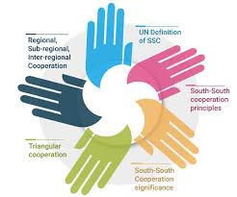
Current Landscape of Triangular Cooperation (TrC)
G20 Priority
Unique Value of TrC
Strengthening Institutional Systems

Slide 3
Proposed ILO Position and Focus Areas:
INTERNATIONAL MEETING ON TRIANGULAR CO-OPERATION
Promoting Decent Work through Triangular Cooperation
Engaging the Private Sector
Strengthening Institutional Capacity
South-South Knowledge Exchange
.

Slide 4
Triangular cooperation in achieving the 2030 Agenda
By promoting decent work and inclusive economic growth.
ensuring that economic growth also delivers social justice, rights at work, and equitable access to opportunities
By bringing labour and employment considerations to the forefront of these collaborations.
countries and stakeholders can collaborate beyond traditional development models, moving towards more inclusive and equitable partnerships.

Slide 5
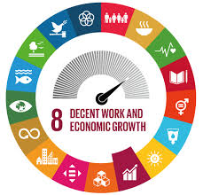
Engaging the Private Sector in TrC
INTERNATIONAL MEETING ON TRIANGULAR CO-OPERATION
Clear Value Propositions
Private Sector Contributions
Examples of Private Sector Engagement

Slide 6
Bridging Cultural Gaps
INTERNATIONAL MEETING ON TRIANGULAR CO-OPERATION
Understanding Cultural Differences
The role of the ILO
brings tripartite constituents together and acts as a facilitator to set cooperation strategies.​
documents and disseminates a wide range of knowledge (compilation of good practices, knowledge exchange platforms and forums).​
forges inclusive partnerships and sets strategic alliances with the purpose of transferring expertise.​
follows-up and reports on major inter-governmental decisions regarding South-South and triangular cooperation.
Capacity-Development Initiatives

Slide 7
Examples of Good Practices
INTERNATIONAL MEETING ON TRIANGULAR CO-OPERATION
Brazil and Tanzania Cooperation in the Cotton Sector:
Diagnostic studies of decent work deficits in the cotton chain and prioritization of challenges such as child labor and social security​.
US-Brazil Initiative (2023): Partnership for Workers’ Rights
EBMO network of employers
Labor Inspection Strengthening in Tajikistan, Romania and Uzbekistan:
Harmonizing national legislation with international standards and strengthening mechanisms for social dialogue​.

Slide 8
Call to Action
INTERNATIONAL MEETING ON TRIANGULAR CO-OPERATION
Decent Work is Fundamental Pillar of Development
SSTC as part of the G20 mechanism
Encourage Private Sector Engagement while promoting human rights
Invest in Cultural Understanding

